Slide 1
Chapter 1:
Introduction to Database Concepts

Slide 2
Database
organized collection of logically related data
may be of any size and complexity
Example:
Salesperson – customer contacts
Corporation – terabytes (trillion bytes) of data

Slide 3
Data
Referred to facts concerning objects and events that could be recorded.
Stored facts of meaningful and significant events, objects and people.
2 Types:
**Structured Data
Name, address, phone numbers
Stored in tabular form
**Unstructured Data
Image, sound, video clips, maps, email, documents

Slide 4
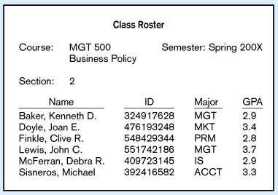
Figure 1: Data in Context
Large volume of facts, difficult to interpret / make decisions

Slide 5
Information
Processed data that is useful in decision making
Figure 2: Information
Useful for decision making / interpretation

Slide 6
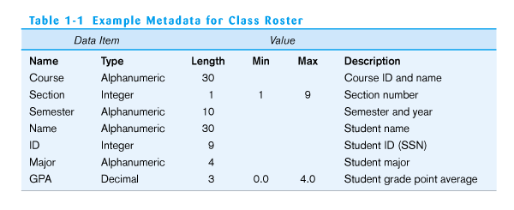
Metadata
Data that describe the properties or characteristics of end-user data and the context of that data.
Examples: Data names, definitions, length or size and values.

Slide 7
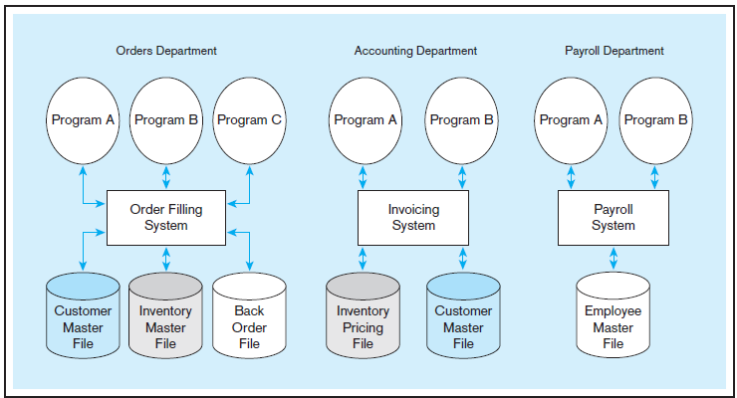
Disadvantages of Traditional File Processing System:
Program-data dependence
Duplication of data
Limited data sharing
Lengthy development times
Excessive program maintenance

Slide 8
THE DATABASE APPROACH
*Data Models
Graphical systems used to capture the nature and relationships among data.
Made up of entities, attributes and relationship
ER-Model – most common data modelling representation

Slide 9
THE DATABASE APPROACH
*Entities
describes a person, a place, an object, an event, or a concept in the business environment for which information must be recorded and retained.
Example:
CUSTOMER and ORDER are entities.
Customer Name (data of the entity CUSTOMER) is an attribute.
Each customer information (like name, address, phone number, etc.) is an instance (record) of CUSTOMER (entity).

Slide 10
THE DATABASE APPROACH
*Relationship
the way in which two or more data sets are linked.
represented by a diamond shape.
Example:
One-to-one
One-to-many
Many-to-many
Many-to-one

Slide 11
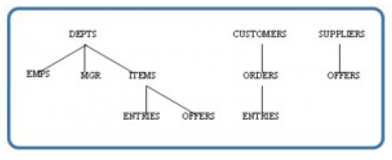
THE DATABASE APPROACH
*Types of Data Models
Hierarchical Model
Data is presented in hierarchical tree structure.
Each branch of the hierarchy represents a number of related records.

Slide 12
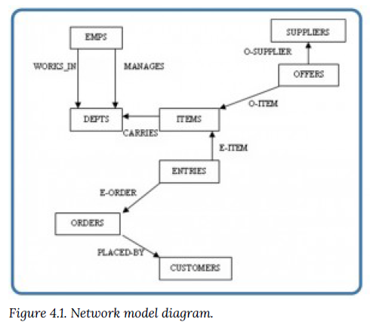
THE DATABASE APPROACH
*Types of Data Models
Network Model
Represents data as record type.
represents a limited type of one to many relationship called a set type.

Slide 13
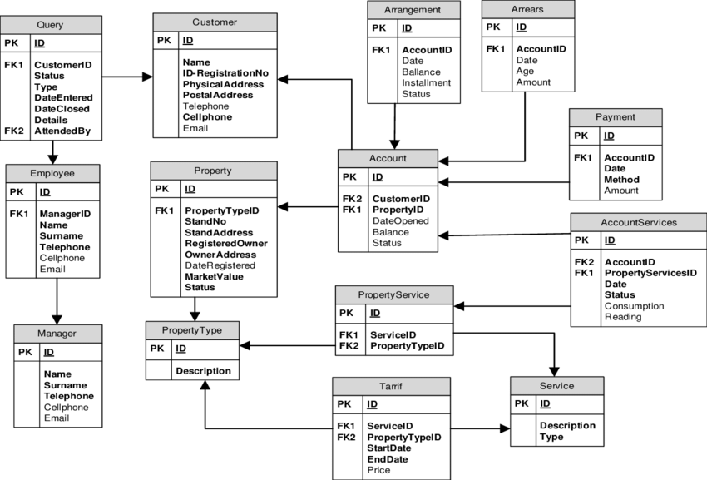
THE DATABASE APPROACH
*Types of Data Models
Relational Model
represents data as relations, or tables.
Each record is said to be an instance of the table.

Slide 14
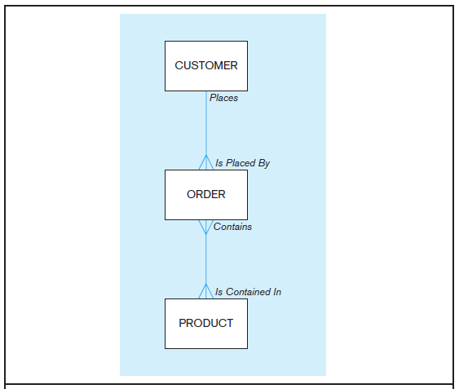
THE DATABASE APPROACH
Enterprise-Level Model
include only the higher-level relationships of customers, orders, and products.

Slide 15
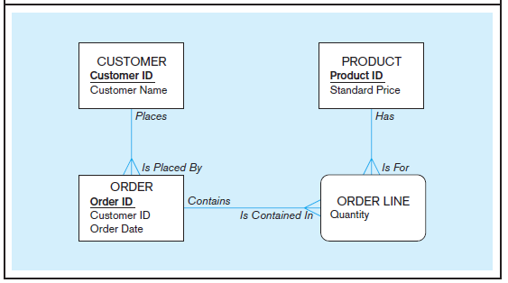
THE DATABASE APPROACH
Project-Level Model
includes additional level of details, such as the further details of an order.

Slide 16
DBMS
(Database Management System)
is a software system that enables the use of a database approach.
Its primary purpose is to provide a systematic method of creating, updating, storing, and retrieving the data stored in a database.
provides facilities for controlling data access, enforcing data integrity, managing concurrency control, and restoring a database.

Slide 17
Advantages of
Database Approach:
Program-Data Independence
Data Independence - separation of data descriptions (metadata) from the application programs that use the data.
Repository – a central location where data descriptions are stored.
Planned Data Redundancy
Good database design attempts to integrate previously data files into a single, logical structure. Example: Product_tbl (name, price, etc.)
Improved Data Consistency
By eliminating or controlling data redundancy, we greatly reduce the opportunities for inconsistency. Example: customer’s address is stored only once

Slide 18
Advantages of
Database Approach:
Improved Data Sharing
Users are granted permission to use the database, and each user is provided one or more user views into the database to facilitate this use. User view is logical description of some portion of the database that is required by a user to perform some task. Example: HR staff needs access to confidential data; customer needs access to product catalog
Increased Productivity of Application Development
A major advantage of the database approach is that it greatly reduces the cost and time for developing new business applications.

Slide 19
Advantages of
Database Approach:
Enforcement of standards
When the database approach is implemented with full management support, the database administration function should be granted singlepoint authority and responsibility for establishing and enforcing data standards.
Improved Data Quality
Constraint - is a rule that cannot be violated by database users.
Improved Data Accessibility and Responsiveness
Reduced Program Maintenance
Improved Decision Support
Databases are designed expressly for decision support applications. Example: database to support customer relationship management, financial analysis, etc.

Slide 20
Advantages of Database Approach:
Program-data independence
Planned data redundancy
Improved data consistency
Improved data sharing
Increased productivity of application development
Enforcement of standards
Improved data quality
Improved data accessibility and responsiveness
Reduced program maintenance
Improved decision support

Slide 21
Cost and Risk of
Database Approach:
New, specialized personnel
Organizations that adopt the database approach need to hire or train individuals to design and implement databases, provide database administration services, and manage a staff of new people.
Installation and Management Cost and Complexity
Installing a system may require upgrades to the hardware , data communications systems and substantial training to keep up with new upgrades.
Conversion Cost
Legacy system - refer to older applications in an organization that are based on file processing and/or older database technology.

Slide 22
Cost and Risk of
Database Approach:
Need to explicit back-up and recovery
Database requires that comprehensive procedures be developed and used for providing backup copies of data and for restoring a database when damage occurs.
Organizational Conflict
Database requires a consensus on data definitions and ownership, as well as responsibilities for accurate data maintenance.

Slide 23
Cost and Risk of Database Approach:
New, Specialized Personnel
Installation and Management Cost and Complexity
Conversion Cost
Need for Explicit Back-up and Recovery
Organizational Conflict

Slide 24
Components of Database
Environment:
Computer-aided Software Engineering (CASE) tools
tools used to design databases and application programs
helps with creation of data models or generate codes needed to create database
Example: Visible Analyst and Microsoft Visio – draw and modify diagrams
Repository
a centralized knowledge base for all data definitions, data relationships, screen and report formats, and other system components.
Contains extended set of metadata important of managing databases and other components of information system.

Slide 25
Components of Database
Environment:
DBMS (Database Management System)
a software system that is used to create, maintain, and provide controlled access to user databases.
Database
organized collection of logically related data, usually designed to meet the information needs of multiple users in an organization.
Application Programs
- used to create and maintain the database and provide information to users.

Slide 26
Components of Database
Environment:
User Interface
includes languages, menus, and other facilities by which users interact with various system components, such as CASE tools, application programs, the DBMS, and the repository.
Data and Database Administrator
Data administrators : responsible for the overall management of data resources in an organization.
Database administrators : responsible for physical database design and for managing technical issues in the database environment.

Slide 27
Components of Database
Environment:
System Developers
systems analysts and programmers who design new application programs
uses CASE tools for system requirements analysis and program design.
End Users
persons throughout the organization who add, delete, and modify data in the database and who request or receive information from it.

Slide 28
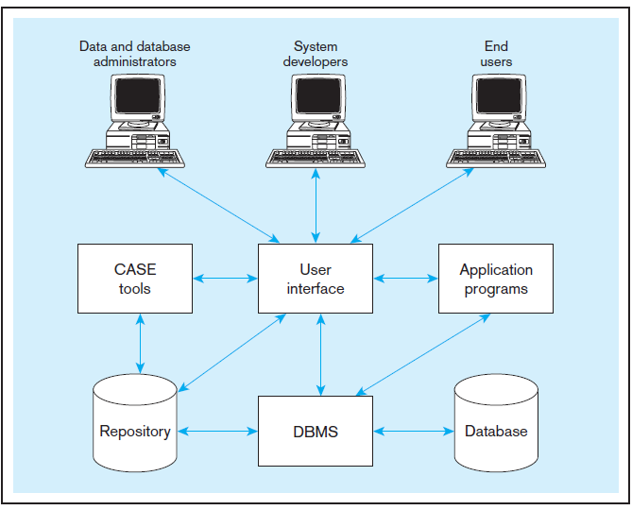

Slide 29
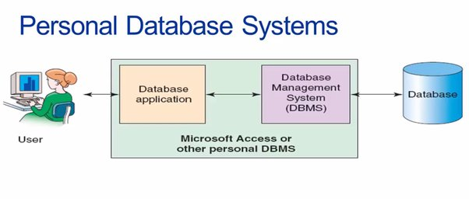
Ranges of Database Application
Personal Database
designed to support one user
resided on personal computers (PCs), including laptops, and increasingly on smartphones and PDAs
Its purpose is to provide the user with ability to manage (store, update, delete, and retrieve) small amounts of data in an efficient manner.
Risks: data cannot easily be shared.

Slide 30
Ranges of Database Application
Two-tier Client/Server Databases
the client requests resources and the server responds directly to the request, using its own resources.
means that the server does not call on another application in order to provide part of the service.
database and the DBMS are stored on a central device (database server) which is also connected to the network.

Slide 31
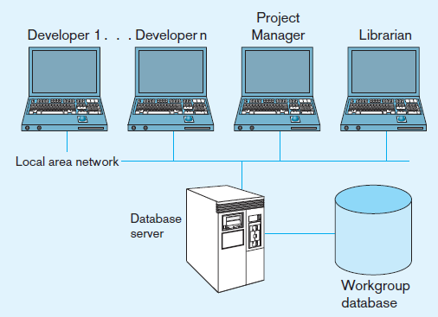
Ranges of Database Application
Two-tier Client/Server Databases
Notes:
Client Tier:
This is the user's computer or device. It has the application software that allows the user to interact with the database (e.g., entering, retrieving, or updating data).
Server Tier:
This is where the database resides. It handles data storage, management, and processing. The server responds to the client’s requests by sending back the requested data or updates.
In simple terms, the client sends requests (like asking for specific data), and the server processes those requests and sends the results back to the client. This structure is commonly used for smaller systems because it's straightforward and easy to manage.

Slide 32
Ranges of Database Application
Multitier Client/Server Database
In 3-tier architecture, there is an intermediary level, meaning that the architecture is generally split up between:
A client (the computer): requests the resources, equipped with a user interface (usually a web browser) for presentation purposes.
The application server (also called middleware): its task is to provide the requested resources but by calling on another server.
The data server: provides the application server with the data that it requires.

Slide 33
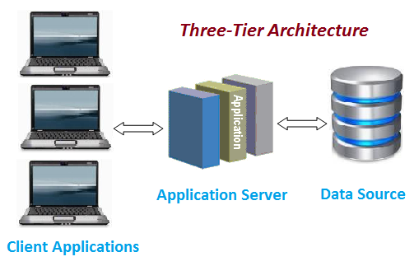
Ranges of Database Application
Multitier Client/Server Databases

Slide 34
Ranges of Database Application
Enterprise Database
are widely used by enterprises in order to strategize, plan and standardize practices.
can handle large organizations with thousands of employees and busy web server with lots of people accessing it simultaneously online (100 to 10,000 individuals).

Slide 35
EVOLUTION OF DATABASE:
1960s
File system was still dominant
First DBMS was introduced and was used primarily for large and complex ventures such as the Apollo moon-landing project.
“proof-of-concept” period (feasibility of managing vast of information was demonstrated.)
Formation of Data Base Task Group - working group founded in 1965 by the Cobol Committee (published a report containing specifications of a Data Manipulation Language (DML) and a Data Definition Language (DDL) for standardization of network database model.)

Slide 36
EVOLUTION OF DATABASE:
1970s
use of database management systems became a commercial reality.
Hierarchical and network DBMs were developed (first generation DBMS)
Relational Data model was also developed by E.F. Codd (2nd generation DBMS)
1980s
Widespread use of relational data model throughout the business world

Slide 37
EVOLUTION OF DATABASE:
1990s
New era of computing
First client/server computing, data warehousing and internet applications became increasingly very important.
Object-oriented database (3rd generation) was introduced during late 1980s

Slide 38
EVOLUTION OF DATABASE:
2000 and beyond
Relational database is still widely used
Object-oriented and object-relational are also garnering attention due to growth in unstructured data/contents.
New possibilities for faster database processing (cheap computer chips and new database technologies)
Sarbanes-Oxley, HIPAA, and Basel Convention : regulations/acts that highlighted the importance of good data management practices.
Notes:
Sarbanes-Oxley to protect investors by improving the accuracy and reliability of corporate financial reports. It requires strict rules for financial transparency and holds companies accountable for fraud.
HIPAA ( Health Insurance Portability and Accountability Act) protects patient health information by ensuring privacy and security standards. It applies to healthcare providers, insurance companies, and other entities handling health data.
Basel Convention An international treaty that controls the movement of hazardous waste between countries, especially from developed to developing nations. It aims to protect human health and the environment from harmful waste.

Slide 39
THANK YOU!!

